Slide 1



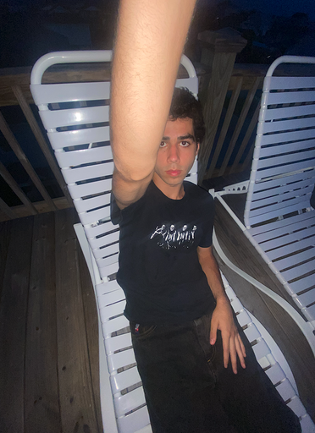

GAME CORNER
Javarris Barnett
Katelyn Bunker
Khaoula Jabour
Lane Byers
Robert Field

Slide 2
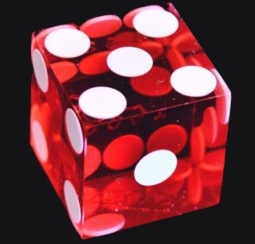
ELEVATOR PITCH
Are you a board game fanatic?
This is the right place to keep track of your collection of games! Sign up to start building your list of favorite games that you want to play again, games that you hate and never want to see, or games that you want to buy and play.

Slide 3

CONCEPT
As a board game fanatic // I would like a place to keep track of my collection of games I've played // so that I can remember what games I've loved and hated

Slide 4
PROCESS
Breakdown of tasks and roles
Javarris Barnett – Server side and backend functionality
Katelyn Bunker – API Calls and Models
Khaoula Jabour – Login and signup
Lane Byers – Dashboard
Robert Field – Powerpoint, README, API Support

Slide 5
PROCESS
Technologies used
API calls and models with JavaScript
Express
Bcrypt
Sequelize
Board Game Atlas
New Technology?
Node Fetch
Less

Slide 6
PROCESS
Challenges
Successes

Slide 7
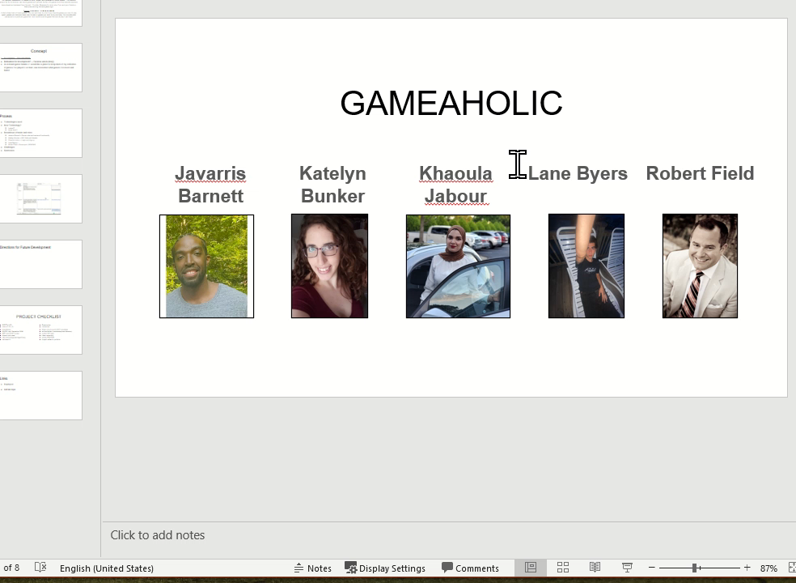
Demo

Slide 8
FUTURE DEVELOPMENT
Hovering over image, user comments scroll
Chat
Delete lists and games

Slide 9
PROJECT CHECKLIST
RESTful API
site is C.R.U.D
Handlebars
MySQL and Sequelize ORM
GET and POST routes
Heroku with data
new technology/package/library
polished UI
Responsive
Interactive
folder structure with MVC paradigm
authentication (cookies/express session)
protect API keys
clean repository
quality README
project added to portfolio

Slide 10
LINKS
Deployed
Game Collection Sign-up
GitHub repo
GitHub Repo

